Slide 2
工作流（Workflow）

Slide 3
Overview
Definition.
Demonstration.
Review:
Implementation.
Workflow portal.

Slide 4
Workflow
Client Applications
Inbound Adapters
Business
Services
Business
Operations
Workflow
Business
Operation
People
Business
Processes
Call
To
Workflow
Ensemble
Notes:
Workflow makes it possible to incorporate human interaction into automated Business Processes.
典型的workflow应用包括order entry, order fulfillment, contract approval and help desk activities.
Workflow is 有人机交互的BO
Using Workflow with Ensemble文档？？改成define workflow

Slide 5
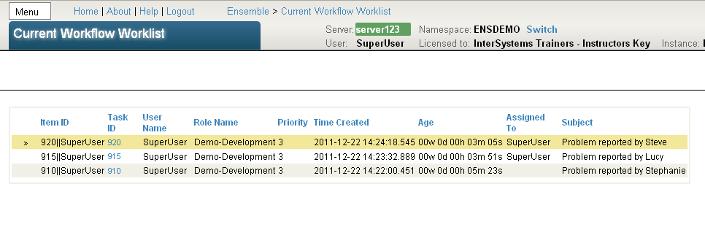
Workflow Tasks
Notes:
A workflow task is an item assigned to a user要求人完成这个任务， 例如打电话， 修计算机，查报账。。
Workflow and workflow tasks can be managed from EnsembleManageWorkflow.
The Workflow Inbox provides an interface for reviewing, assigning, completing and auditing tasks.
The Workflow Inbox is reached from DeepSeeUser PortalWorkflow Inbox.

Slide 6
Workflow Facts
Task associated with one role.
User has one or more roles.
User assigned task.
Workflow Business Operation controls assignment algorithm.
User works with task through Workflow Inbox accessible through DeepSee User Portal.
DeepSee → User Portal → Workflow Inbox.
Notes:
A task is assigned to a user with an appropriate role.
A task is associated with only one role, but a user may have multiple roles. This allows a user to work on a variety of tasks, if necessary.
The Ensemble workflow engine automates the distribution of tasks among users. Tasks are distributed automatically according to a predefined strategy.
Ensemble provides a variety of distribution strategies, such as assignment by job title and assignment by current user workload.
Custom task distribution strategies can also be created.
Using the Workflow Inbox, a user can accept a task, add comments to a task, relinquish a task and a variety of other activities.

Slide 7
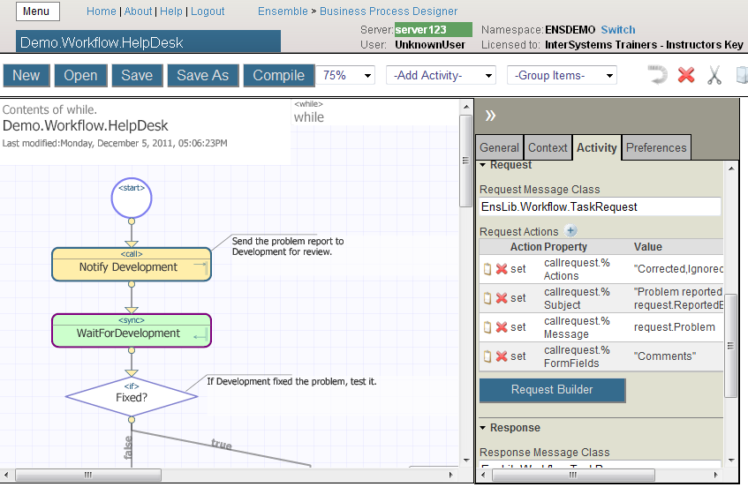
Demonstration

Slide 8

Workflow Creation
Steps to Create Workflow 1. Create users and roles.
2. Add workflow Business Operation to Production. - Name must match a role.
3. Update Business Process to use workflow.
a. Call workflow Bus Op.
b. Sync to wait for workflow.
c. Use workflow results.
Notes:
Defining Workflows provides further details about the specific steps necessary for adding workflow to a Production.

Slide 9
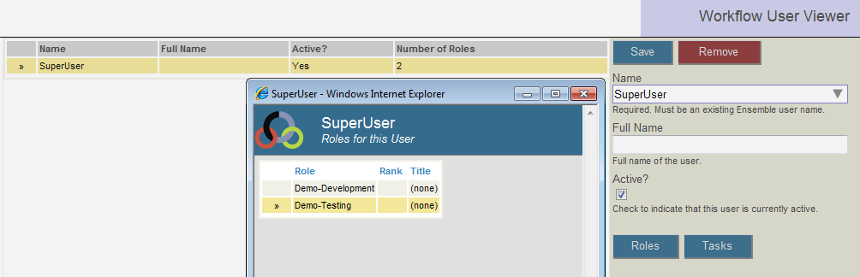
用户和角色
Define in Ensemble → Manage → Workflow:
Roles.
Users.
Roles for each user.
选择ensemble用户为workflow用户
Notes:
To create a role: Ensemble Manage  Workflow  Workflow Roles  Complete fields for new role  Save.
To create a user: Ensemble Manage  Workflow  Workflow Users  Choose existing Ensemble user from drop-down  Complete other fields  Save.
To assign a user to role: Ensemble  Manage  Workflow  Workflow Roles  Select role  Add button.
To access the Workflow Inbox, the workflow user must be a Caché user.
For details on creating and managing users and roles, refer to Managing Ensemble  Managing Workflow Roles, Users, and Tasks.

Slide 10
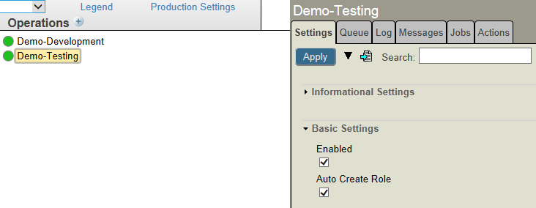
自动创建角色属性
Auto Create Role = True
Creates role with first attempt to send task to workflow Business Operation with no corresponding role.
Add users once role created.
Auto Create Role = False
Create role manually prior to first task sent to workflow Business Operation.
Notes:
If a workflow BO没有角色第一次调用时，role defined when it is first called, a role will automatically be created.
No user can accept the task 直到用户被加到这个属性
如果所有角色都会被先生成，把这个开关关上

Slide 11
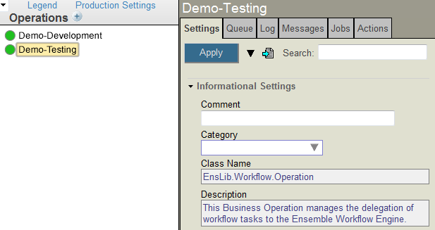
添加工作流到Production
Add workflow Business Operation to Production.
可以使用EnsLib.Workflow.Operation或者客户自己写 Business Operation.
名字必须和角色名一致
角色名字
Default distribution
Notes:
The workflow Business Operation must be added to the Production. The name must be the same as the role name the tasks will be assigned to.
A workflow Business Operation is a special-purpose Business Operation that represents a role.
A workflow Business Operation must be configured as a Business Operation within the same Production as the Business Process that calls the workflow Business Operation.

Slide 12
任务分配策略
工作流引擎给该角色的一个用户分配任务
默认情况下，先来先服务，然后是按job title, 然后是名字。。。
可以自己指定策略.
创建EnsLib.Workflow.TaskResponse子类
Override at least OnNewTask() method.
Invoke custom task response by setting %TaskHandler in request to response class:
set callrequest.%TaskHandler="MyApp.CustomTaskResponse"
Notes:
The distribution of tasks to people through a workflow Business Operation is an ordinary Business Operation to Ensemble with a custom response class.
EnsLib.Workflow.TaskResponse provides a default Task Distribution algorithm that can be overridden by creating an inherited class. If it is not overridden, the tasks are distributed as follows:
First come, first served (FCFS).
Assignment by job title.
Assignment by name.
Assignment by a user-defined ranking.
Assignment by current user workload.
...and more.
Refer to Defining Workflow  Including Custom Features in a Workflow for details on implementing and using a custom task distribution.
When creating your own distribution algorithm, make the assignments through roles rather than users. People change in an organization, but roles are relatively static. Employees no longer performing a function can be removed from a role. New users can be assigned to existing roles.

Slide 13
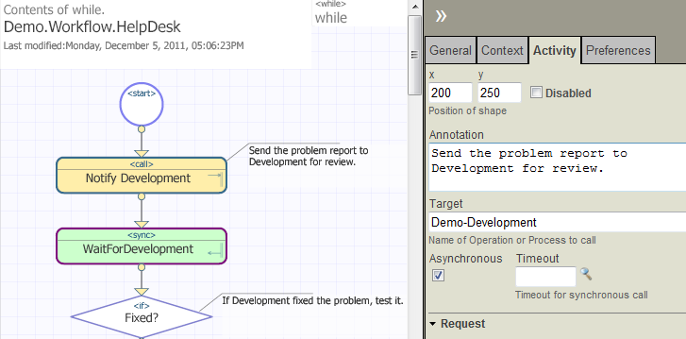
调用工作流
Call workflow Business Operation from Business Process.
Each call creates workflow task.
Sync activity required to catch results.
Blank Timeout means task will not time out.
Notes:
Each call to a workflow Business Operation will create a task. When the task is completed, the <call> will return. The Sync activity is required to wait for the response to the workflow Business Operation.
The Timeout value indicates how long to allow a task to remain with an Unassigned status before discarding the task.
Typically, you do not want a task to be discarded (as a result of timing out) before the task is completed by someone.
If there is a reason to have a task available for only a certain amount of time, specify a Timeout value.
After the Sync activity, you can test if the Sync activity timed out by checking the execution context variable “synctimedout”. Its value is either 1 or 0.
If the task times out before it is completed, the task gets a status of Discarded (and turns pink in the Task Browser).
To provide a customized Timeout response, override OnCancel() in the message Ens.Workflow.TaskResponse. This allows for an alternative to discarding a timed out task.

Slide 14
调用工作流
Send request EnsLib.Workflow.TaskRequest.
Set properties appropriately.
Send asynchronously.
Receive response EnsLib.Workflow.TaskResponse.
Save necessary returned information to context properties.
Business
Process
EnsLib.Workflow.TaskRequest
EnsLib.Workflow.TaskResponse
Workflow Business Operation
Notes:
A Business Process sends a Task Request to a workflow Business Operation in exactly the same manner as any other Business Operation.
The call to the workflow Business Operation must be asynchronous. The call must be followed by a Sync activity to wait for the result.
The workflow Business Operation will respond with a deferred response.
To do this, the workflow Business Operation automatically sets the Task Request status to Deferred with ..DeferResponse(.tToken). The Task Request has a Deferred status until the workflow Business Operation returns, i.e. the task is completed.
Once the workflow Business Operation returns, the Task Request status changes to Completed and the Task Response is also marked Completed.

Slide 15

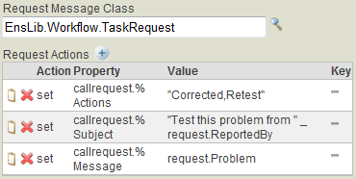
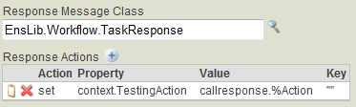
使用Properties
Notes:
当设定callrequest (EnsLib.Workflow.TaskRequest) to a workflow BO, set the properties to indicate how the Task Request is handled. Below are some of the more popular properties. Refer to Defining Workflows  Developing a Workflow  Defining the Task Request for a list of all possible properties and details. Some include:
%Actions – List of defined actions for the task. These determine the label on the buttons displayed when a user reviews a task.
%Subject – A summary of the task displayed when the user reviews the task.
%Message – The message body displayed when the user reviews the task.
%FormFields – List of editable fields to appear in the form associated with the task.
When receiving the callresponse (EnsLib.Workflow.TaskRequest) from a workflow Business Operation, save any necessary callresponse property values in a context property. Some response properties indicate how the Task Response was handled.
Processing after the workflow returns may be based on how, or who, handled the task. Having this information in a context variable, allows the Business Process to make decisions based on the callresponse values.
Below are some of the more popular properties. Refer to Defining Workflow  Developing a Workflow  Using the Task Response for a list of all possible properties. Some include:
%Action – Value of the action that the user selected to complete the task.
%RoleName – Name of the role that handled the request.
%UserName – Name of the user that handled the request.

Slide 16
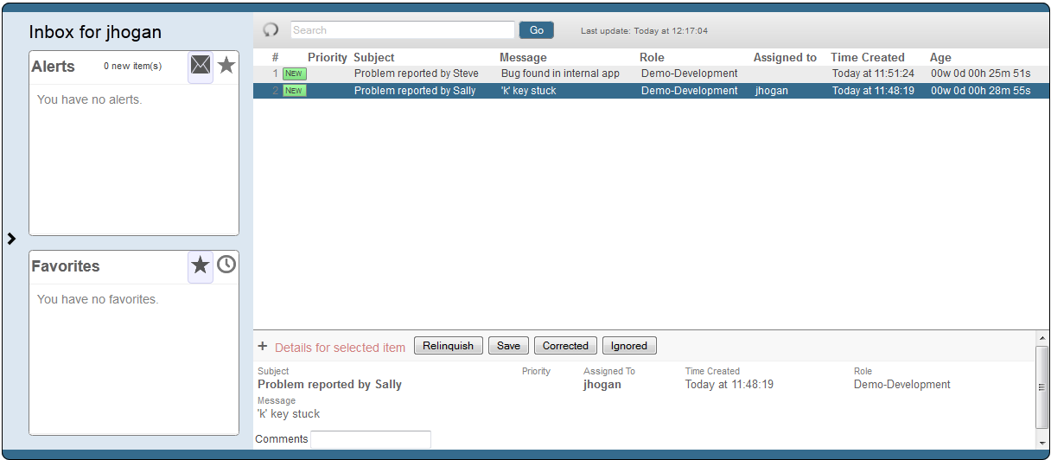
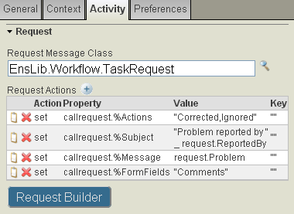
使用Properties
从Task Request收到的信息
Notes:
Properties for EnsLib.Workflow.TaskRequest control what information is provided to the user for a task in the workflow portal. For example, %Subject and %Message determine what subject and message are displayed.
Properties for EnsLib.Workflow.TaskRequest can also control the look of the task form by adding buttons, adding text entry fields or changing to any other extent required.

Slide 17
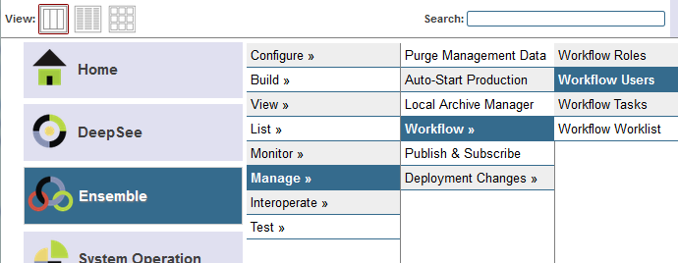
Workflow配置流程
Ensemble → Manage → Workflow used to manage workflow.
Create roles.
Create users.
Assign tasks.
View worklist details.
Notes:
The Ensemble  Manage  Workflow provides the following selection:
Workflow Roles – View, modify or create workflow roles.
Workflow Users – View, modify or create workflow users.
Workflow Tasks – List all tasks that have passed through the Production. Assign a task to a specific user. Edit or cancel a task. Tasks are color-coded.
Blue – Assigned task.
Yellow – Unassigned task.
Grey – Completed task.
Pink – Discarded task (no response before timeout limit exceeded).
Workflow Worklist – List all currently active tasks (assigned or unassigned).

Slide 18
Workflow配置流程
Users work with tasks in Workflow Inbox.
DeepSee → User Portal → Workflow Inbox.
Notes:
Users work with workflow tasks in the Workflow Inbox. From here they can view the details of the tasks. They can also update, relinquish or complete the task.
The action buttons available to the user are customizable.

Slide 19
延迟响应(Deferred Response)
Business Operation can defer its response.
DeferResponse(token)
Message status is “Deferred”.
Send message later.
SendDeferredResponse(token,ResponseBody)
Used with workflow Business Operations.
Response returned when person provides response.
Notes:
A Business Operation can defer its response. Instead of sending the response in the Business Operation, the response is sent at a later time by another business component.
This is used with workflow. It can also be used when the outbound request goes out in one way and the reply comes back in through a different route, such as a Business Service, or when the response from the external resource will take a long time.
To defer a response in a Business Operation, do the following:
1) Defer the response in the Business Operation using: sc = me.DeferResponse(token) (Basic) The token is a string and is returned via the reference argument to the method DeferResponse(). Later, token will be used to send the response. This method also sets ..DeferResponse=1, which causes the response to be deferred. The Business Operation quits without sending the response, but with ..DeferResponse set to 1, this allows some other code to later send the response using the token. Once a message is in a deferred state, the Status property of the MessageHeader is “Deferred".
2) Send the response at a later point: sc = me.SendDeferredResponse(token,ResponseBody) (Basic) or set sc= ..SendDeferredResponse(token,ResponseBody) (ObjectScript) This will cause the response to be sent back to the sender of the original request message. The first argument is the token that was created by the call to DeferResponse in the Business Operation. The second argument is an instance of the appropriate response. When the original sender of the request receives the response, the Status property of the MessageHeader is set to “Completed”.

Slide 20
Summary
What are the key points for this module?

